Slide 1
Counterterrorism Data Analysis
Group 8
Gowtham Naidu Gorji
Jianhui Ding
Prachi Wilson Jacob

Slide 2
Introduction
Terrorism refers to the multiple groups or individuals who commit some violent acts for achieving some personal objectives and impose some fear and disruption among the society.
Terrorism surpasses geographical, ethnic, and religious boundaries, and its tactics and objectives vary, encompassing attacks on civilians as well as critical infrastructure.
Global terrorism is a threat that cuts beyond national borders and impacts all levels of society, from individual people to governments and international institutions.
Technological advances and globalization have allowed terrorist ideologies to spread more quickly and widely.
These factors also facilitate the recruitment, planning, and execution of terrorist attacks across borders.
Nations are facing many issues in safeguarding their people from the terrorist attacks which includes political unrest and social injustice.
Some countries may face terrorist attacks due to the difference between the groups based on their religion and cultural conflicts, aiming to promote their religion as the greatest in the world.

Slide 3
Overview of Global Terrorism Database(GTD)
GTD is an open source database which consists of information related to terrorist attacks occurred across the world from 1970 to 2020 and consists of info about 200,000 Terrorist Attacks which has 88,000 bombings, 19,000 assassinations and 11,000 kidnappings since 1970.
This database is useful for researchers,security analysts and policymakers to identify and access the threats caused due to terrorist attacks and recognize the pattern of attacks and mitigate them in future.
GTD initially was organized in 2001 when researchers at University of Maryland obtained the large database which was collected from Pinkerton Global Intelligence Services (PGIS),was maintained by National Consortium for the Study of Terrorism and Responses to Terrorism (START).
Overall, The GTD is accessible to public and useful in analyzing the patterns, tactics used by terrorists and change of terrorism over the years.

Slide 4
Business Question
What are the emerging trends in Terrorist activities globally over a decade?
How to assess the past risk levels of terrorist activities?
Identify the most prominent terrorist groups based on the damage they are causing at a global/regional level and the casualty rates.
How can we support counter terrorism decision making regionally using Global Terrorism Database(GTD)?

Slide 5
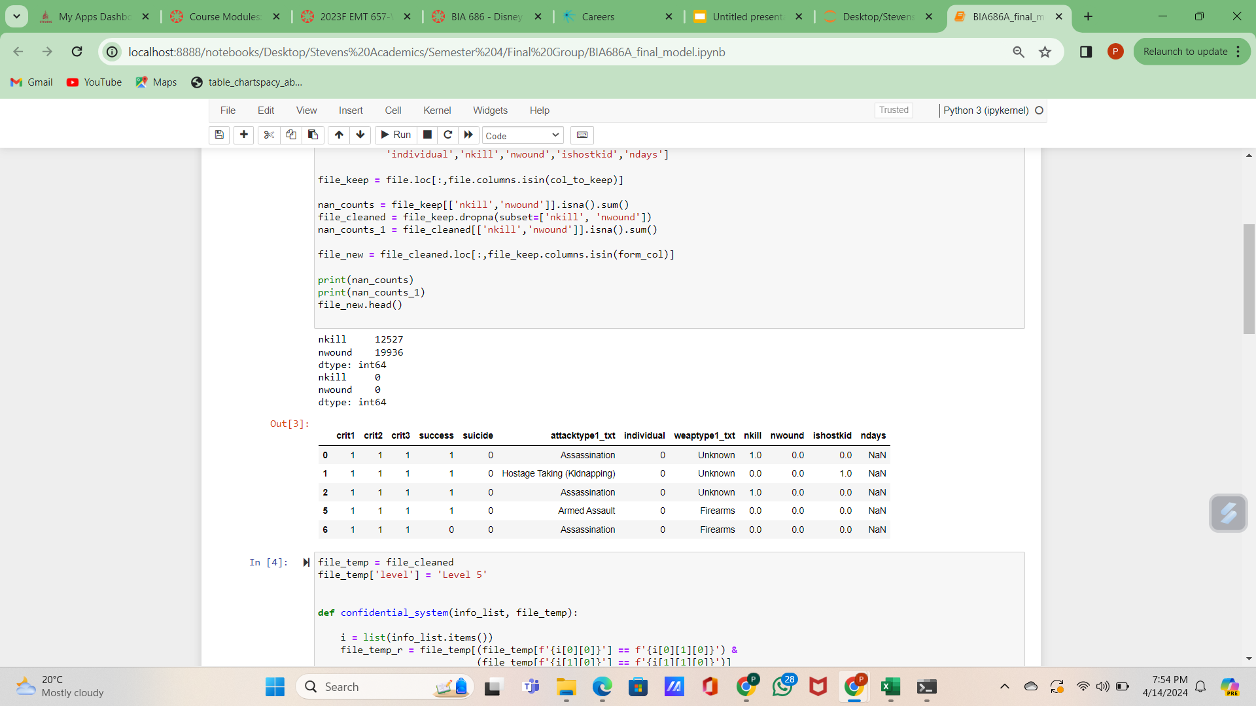
Data Description
There are 135 columns and 209,706 rows in our dataset, out of which we picked these to determine the risk factor:
crit1, crit2, crit3 (binary): indicates whether certain criteria are met for the attack to be considered a terrorist one
success (binary): indicates whether the attack was a success or not
suicide (binary): indicates whether it was a suicide/non-suicidal attack
attacktype1_txt (categorical): describes what type of attack occurred
weaptype1_txt (categorical): describes the primary weapon used
individual (binary): indicates whether it was carried out by an individual or group
nkill (numerical): number of people who died, including the perpetrators
nwound (numerical): number of people who were critically/severely wounded, including the perpetrators
ishostkid (binary): indicates whether it was a hostage taking/kidnapping situation
ndays (numerical): in case of a hostage situation, this indicates the number of days individual(s) were held hostage

Slide 6
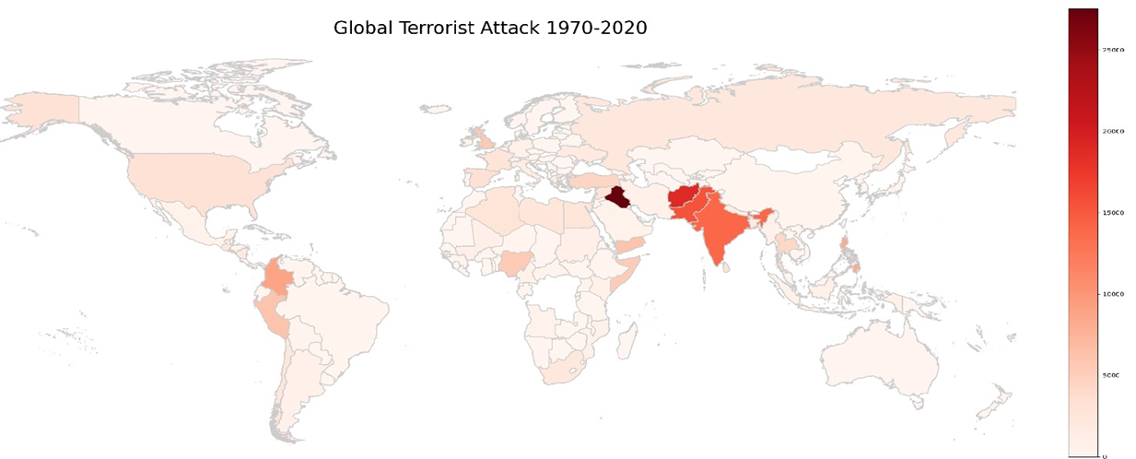
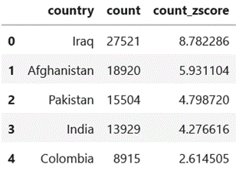
EDA: Overview
Iraq, Afghanistan, Pakistan, India and Colombia are top five most targeted country.
South & Middle-East Asia and South America are most targeted region

Slide 7
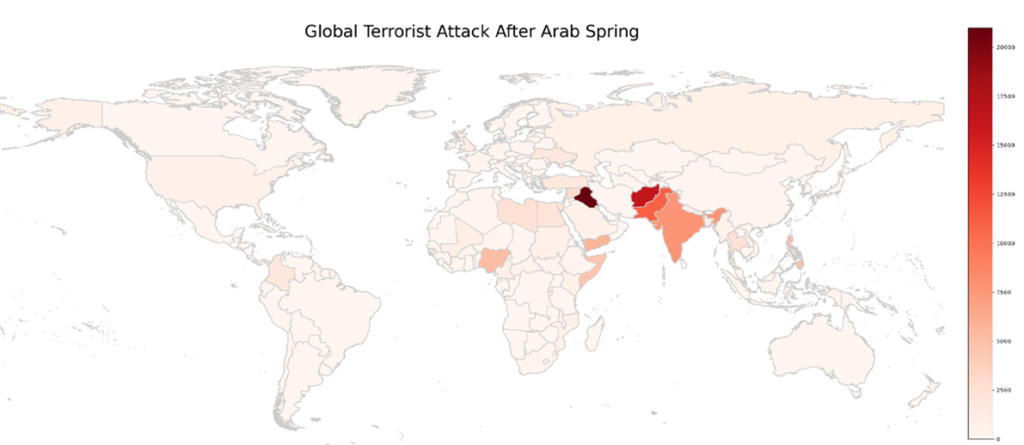
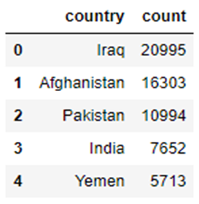
EDA: Overview
Impact of the Arab Spring on Terrorism, Began with rallies, riots, and rebellions across the Middle East in late 2010.
Map shows terrorist activity intensity by color. High frequency of attacks with Iraq being the most affected.
Countries with violent conflicts and politically unstable during the Arab Spring, like Yemen, experienced a significant increase in terrorism.

Slide 8
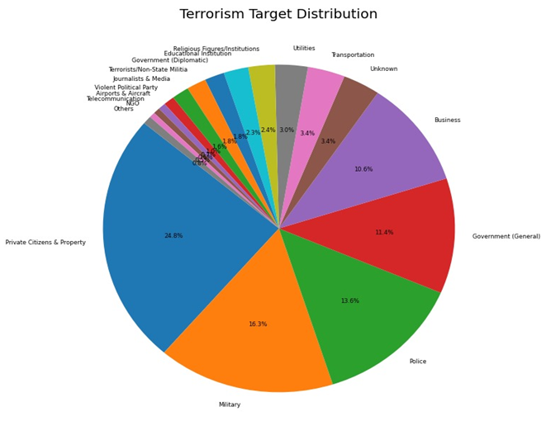
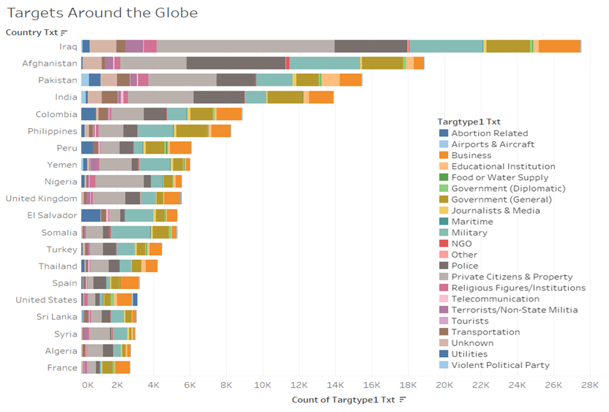
EDA: Target Type
The global distribution of terrorist attacks targets
Top Five: private citizens and property, military, police, government, and business
The distribution of terrorist attacks targets in top targeted countries:
E.g: Iraq - Private citizens & Property, Somalia - Military, US - Business

Slide 9
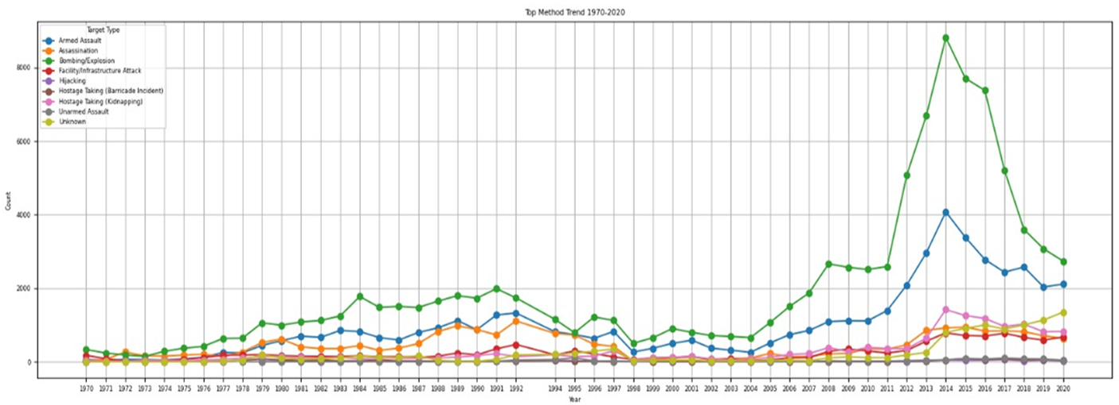

EDA: Attack Type
Top five methods terrorism attack: Bombing, Armed Assault, Assassination, Kidnaping, Infrastructure attack.
Mostly aim to cause massive fatality
Bombing and Armed Assault increased since Arab Spring (dictators overthrown).
Dropped after 2014 when regional politics trended to stable.

Slide 10
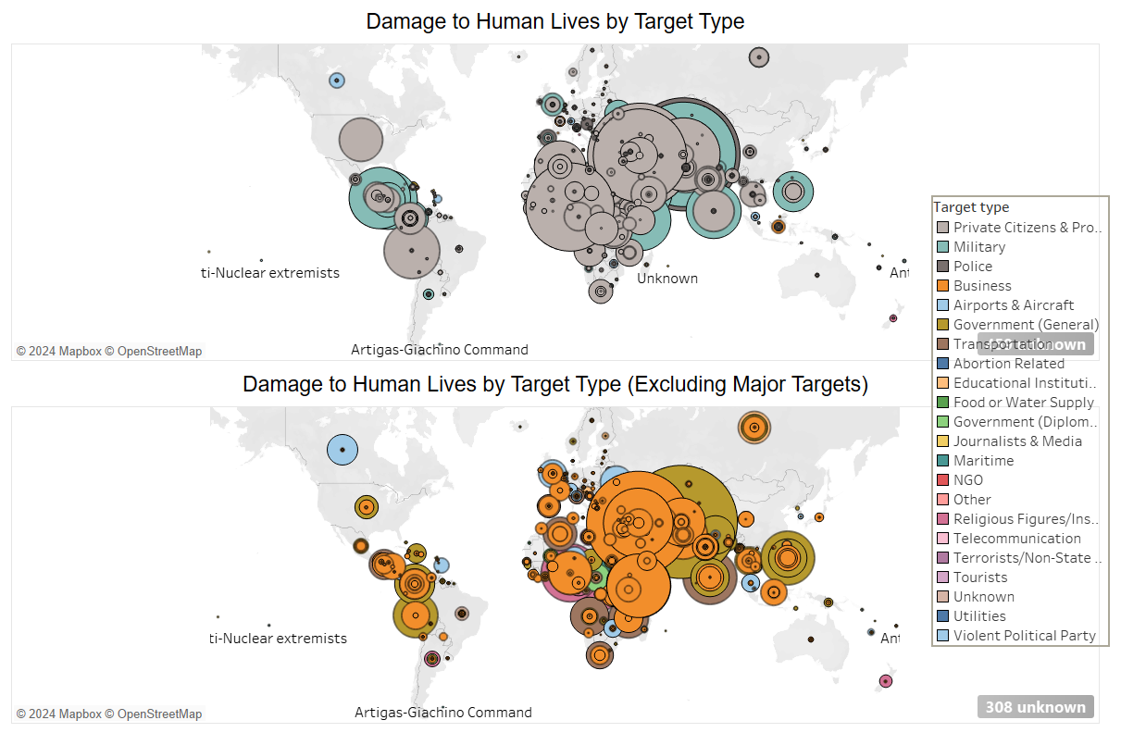

Slide 11
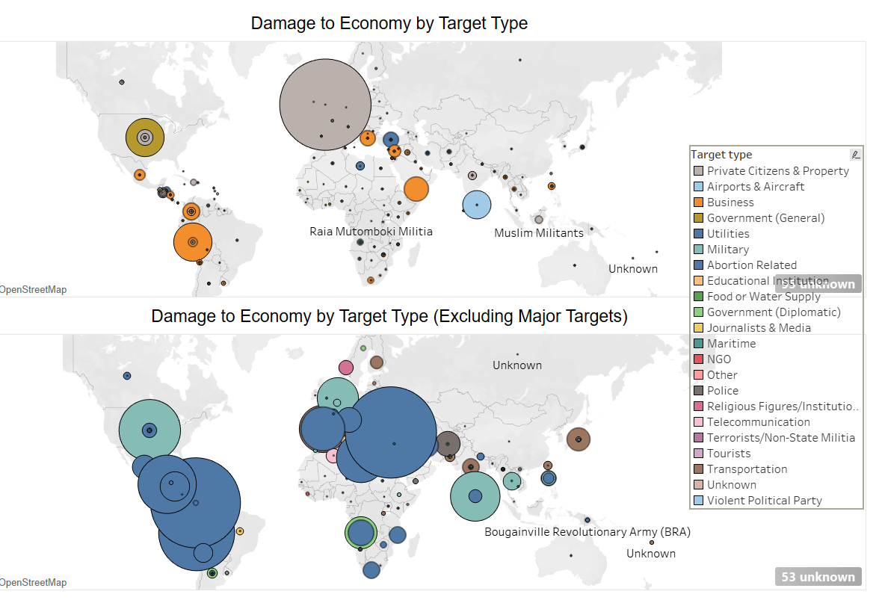

Slide 12
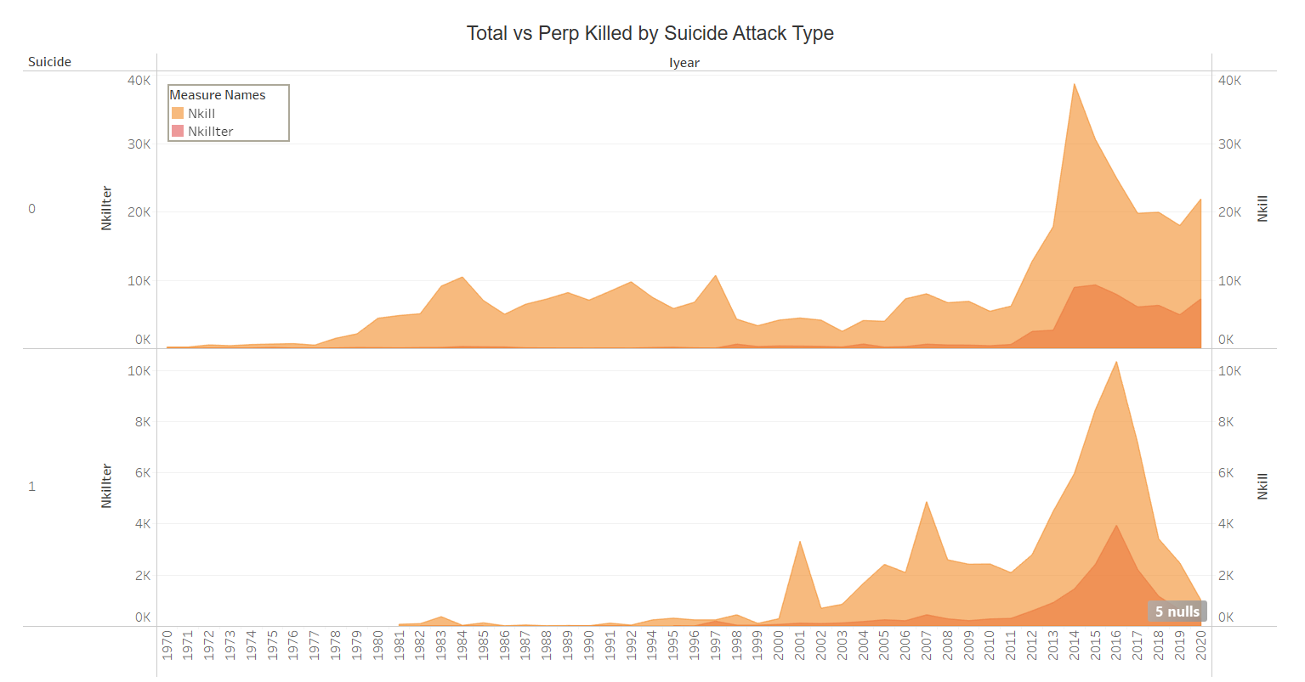

Slide 13
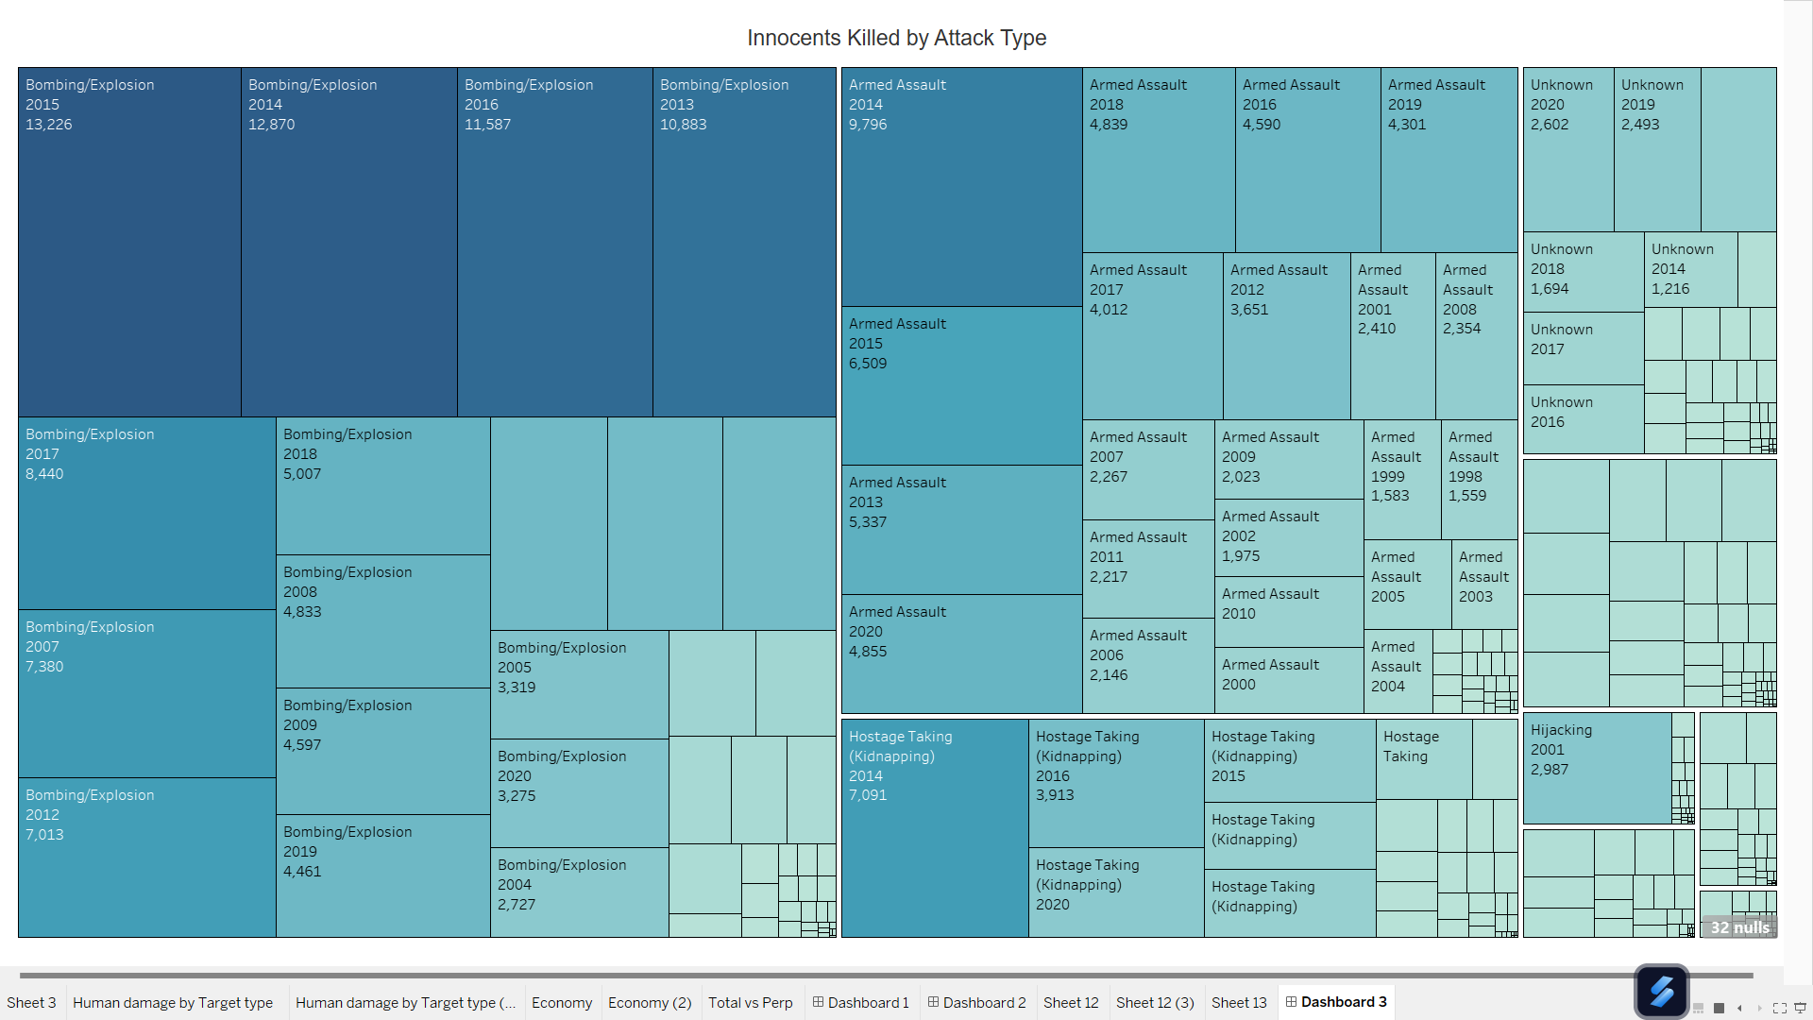
Assassination (1,121)
Hijacking (2,987)
Hostage Taking (617)
Facility/Infrastructure Attack (438)
Unarmed Assault (203)
Notes:
I will leave slide 8,9 for you to edit, it is kinda complicated. I am afraid making misunderstanding - Chris :)

Slide 14
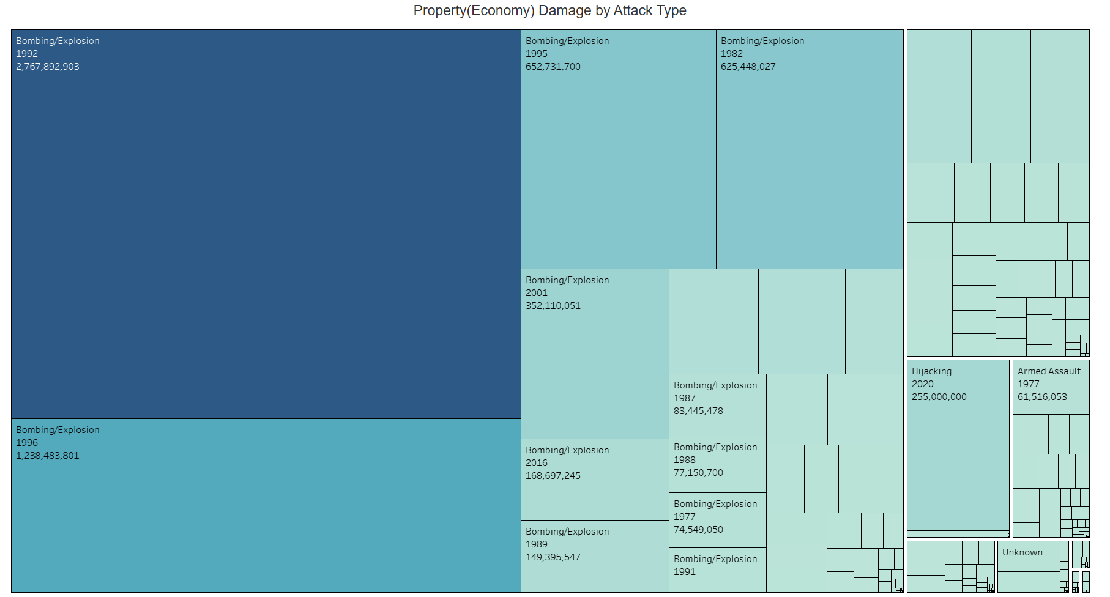
Facility/Infrastructure Attack (123 M)
Hostage Taking (10.2 M)
Hostage Taking (10.2 M)
Unknown (29.5 M)
Kidnapping (3.2 M)
Assassination (620 K)
Unarmed Assault (1.6 M)

Slide 15
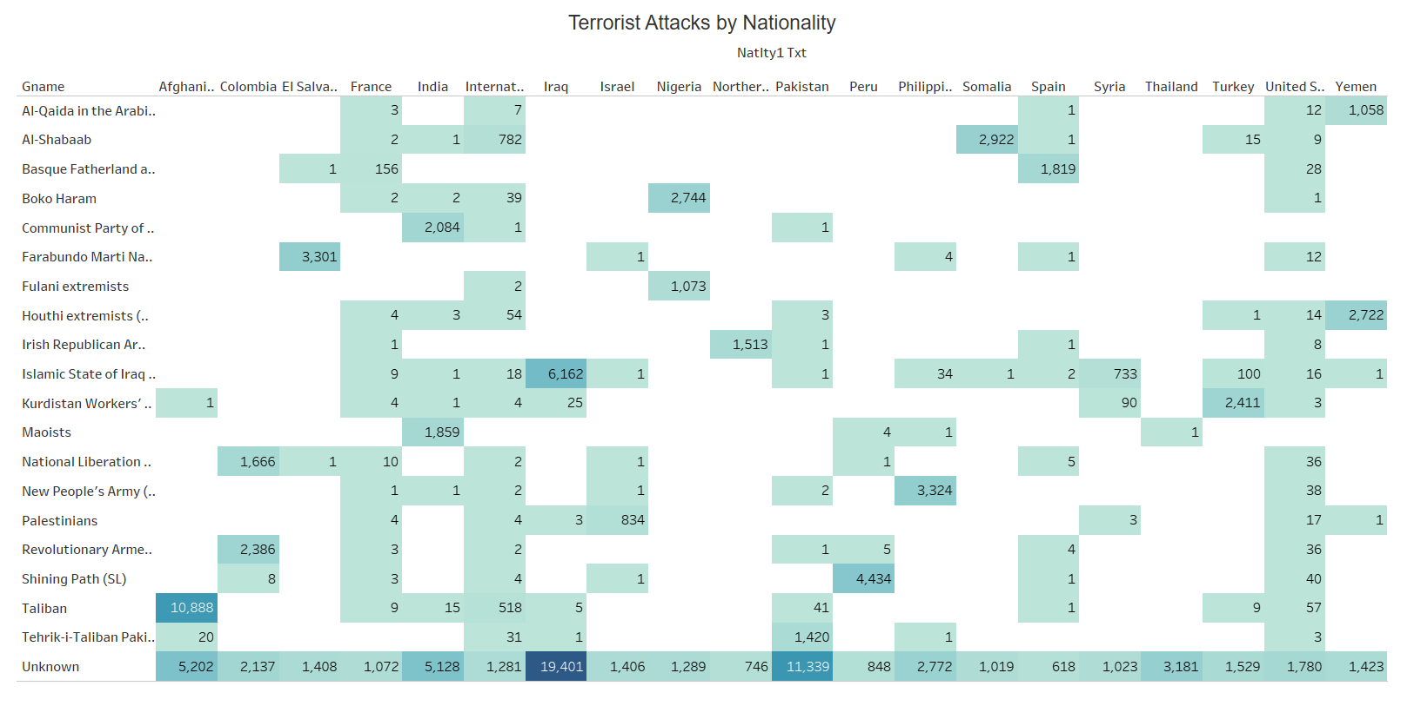

Slide 16
Process to Assess Risk
Normalization:
Normalized all the columns, multiplied and added them according to the formula
Some very big outliers affect the final values, gives inconclusive results
Model:
Created an equation, figured out rankings that should be given (between 1-4: 4 levels of risk)
Assigned weights that should be multiplied based on conditions of risk severity
Assigning Index:
Determined the index to be assigned to each value of a particular column
Numerical columns were multiplied with the assigned weights
Output:
Substituting all these index values into one equation, we get the risk index value for each row. The final index values are categorized from low to high levels of risk
Particular high alert risk situations can be identified, measures can be taken accordingly

Slide 17
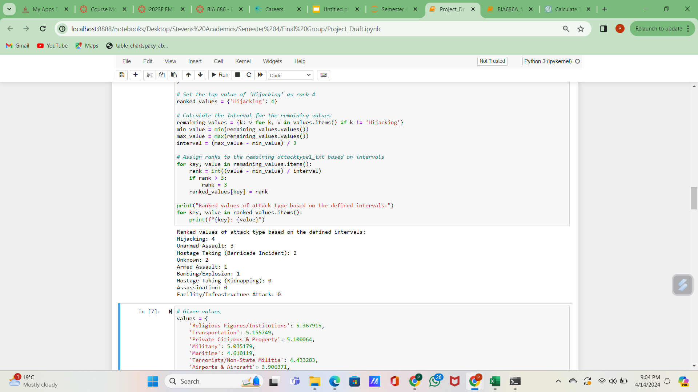
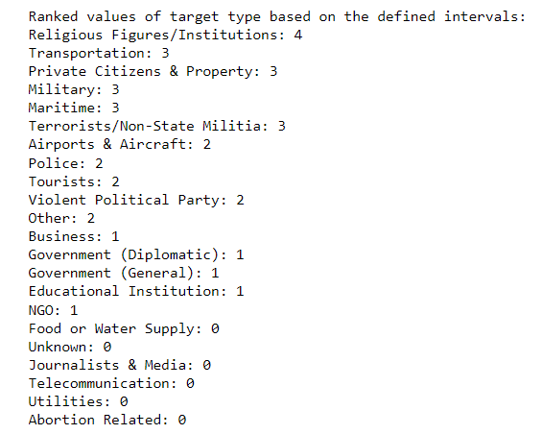
Attack & Target types
Assessing risk hierarchy:
lives_harmed = nkill + 0.5*nwound (propvalue - missing values)
grouped by attacktype1_txt to find the mean values of all attack types, and did the same for target type
Assigning a rank:
considering the range of all mean values, split it into 4 intervals which gives 5 levels of risk
rows assigned values 1 through 5 and were stored as indexes
attacktype1_txt had an outlier which was assigned level 4 and the range of the remaining values was considered to split into 4 intervals

Slide 18

Risk Assessment Model:
In equation:
is fatal_index, determined by number of death in each incident (assigned ranks based on distribution). Range: [0,1]
is wounded_index, determined by number of injured in each incident (same above). Range: [0,1]
is hostage_index, determined by the number of victims and days being kidnapped. Range: [0,1]
is success weight, determined by whether the incident is succeeded. Range: 0. 5 or 1
is suicide_weight, determined by whether the perpetrator(s) is suicide. Range: 1 or 2.
is individual_weight, determined by whether the perpetrator(s) belong to a terrorist group. Range: 0.75 or 1
is classification index, determined by:
the incident is aimed at attaining a political, economic, religious, or social goal
the incident is an intention to coerce, intimidate, or publicize to a larger audience(s)
the incident is targeted non-combatants

Slide 19
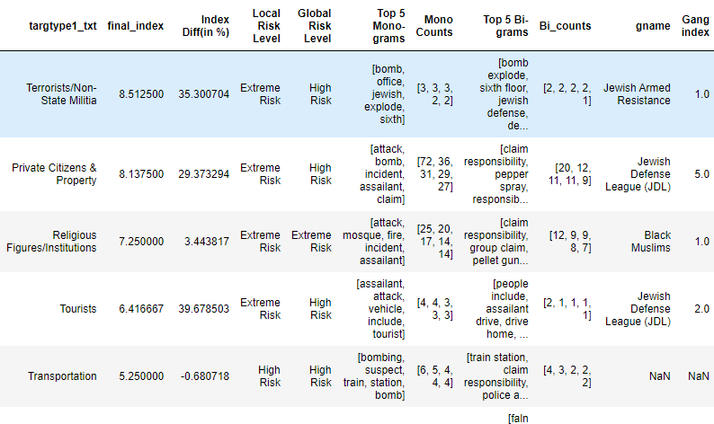
Confidential System:
Outcome Goal:
Aid local counter-terrorism agencies in decision-making by leveraging insights from local historical and global GTD data.
System Mechanism:
Operates on a previously developed assessment model.
Inputs are 3 level geographical information: Country, State, City.
Users can mixed up different level:
E.g: [United States, New Jersey State] & [United States, New York City]
System Outcome:
Generates a report providing insights on the user-selected location regarding target type.
Top 5 Mono-Gram/Bi-Gram:
Top 5 most occurred words/phrases within the summary and news titles collected.
Gang Index:
How many time the terrorist group(s) attack these targets within the area input.

Slide 20
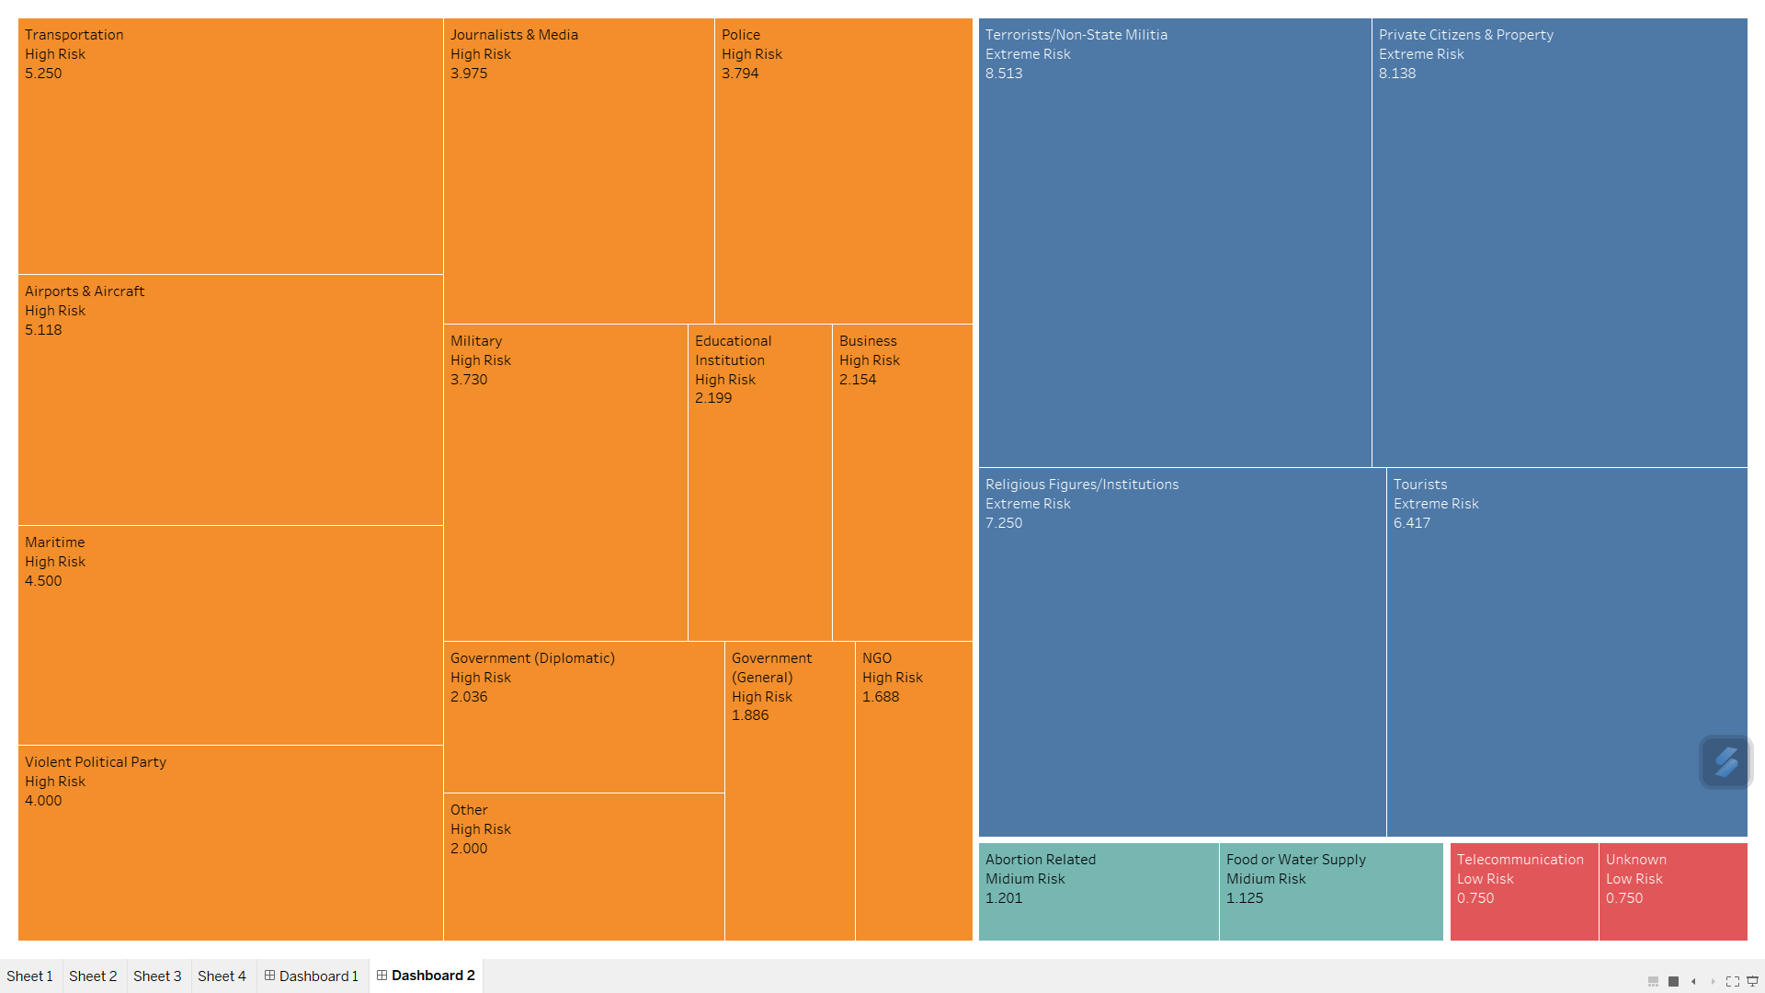
Local Risk Level by Target type
There are 4 target types with an Extreme risk level
Most of the targets have a High risk level
Only a couple of the target types have a Medium/Lower level of risk

Slide 21
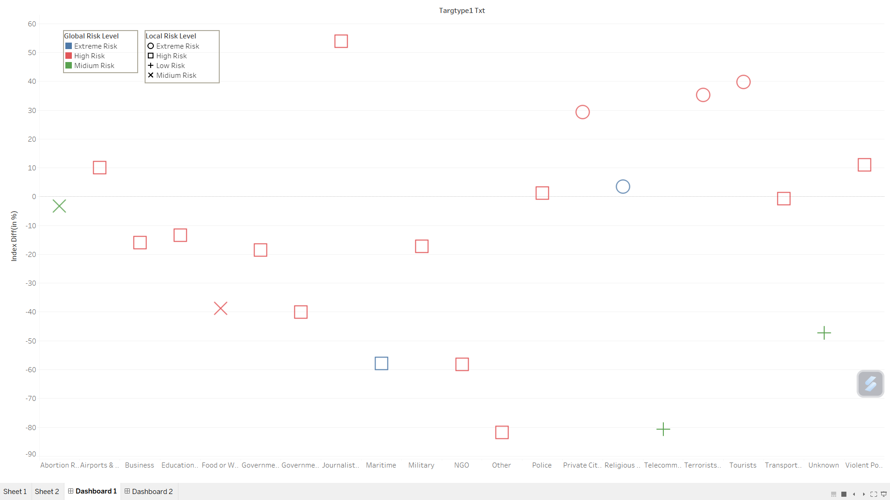
Global Risk Index Difference
“Telecommunication” and “Other” targets have a very large negative index; even though they have medium and high global levels respectively.
All targets having extreme local risks have a high global risk with a positive difference.
Only religious targets have extreme risk levels on both local and global scales; Maritime has a high local but an extreme global risk.

Slide 22
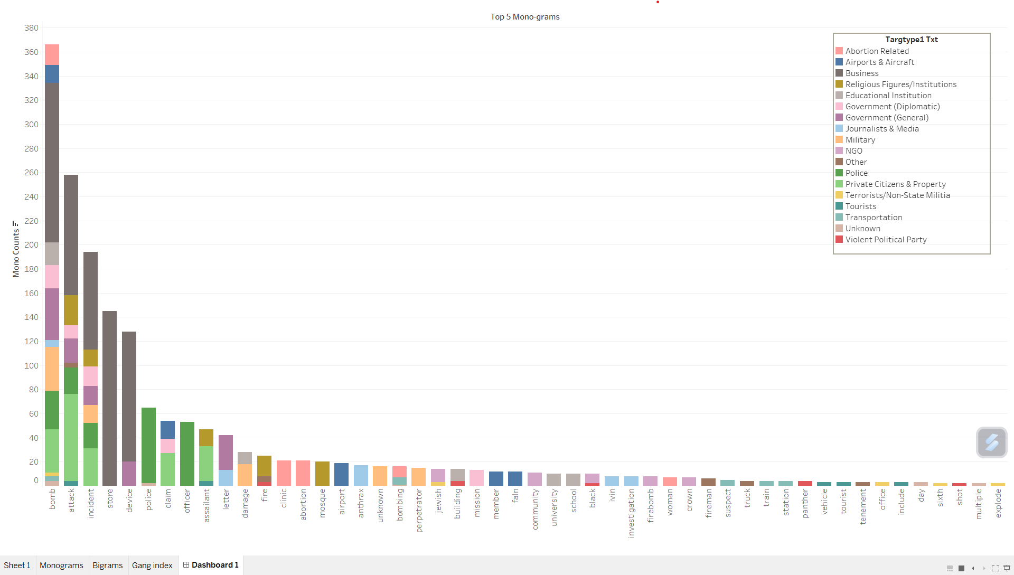
Top 5 Monograms by Target type
Most frequently used words: bomb, attack, incident, store, device
The first 3 words have been used in 7-13 target types
The top 5 words have most commonly been used for the “Business” target type
Abortion: abortion, clinic, woman

Slide 23
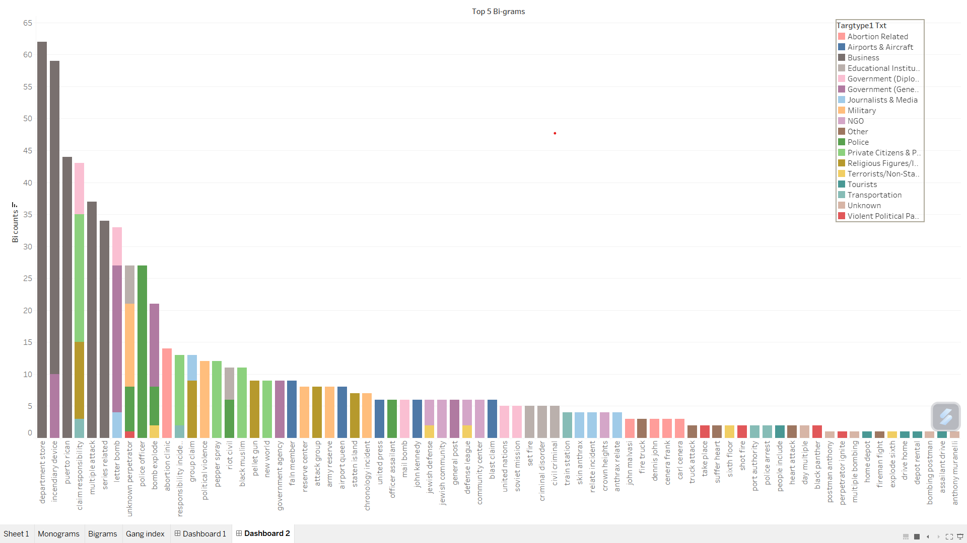
Top 5 Bigrams by Target type
Top bigrams: department store, incendiary device, puerto rican - “Business” target
Abortion: abortion clinic; Airports: john kennedy; Military: army reserve; Transportation: port authority

Slide 24
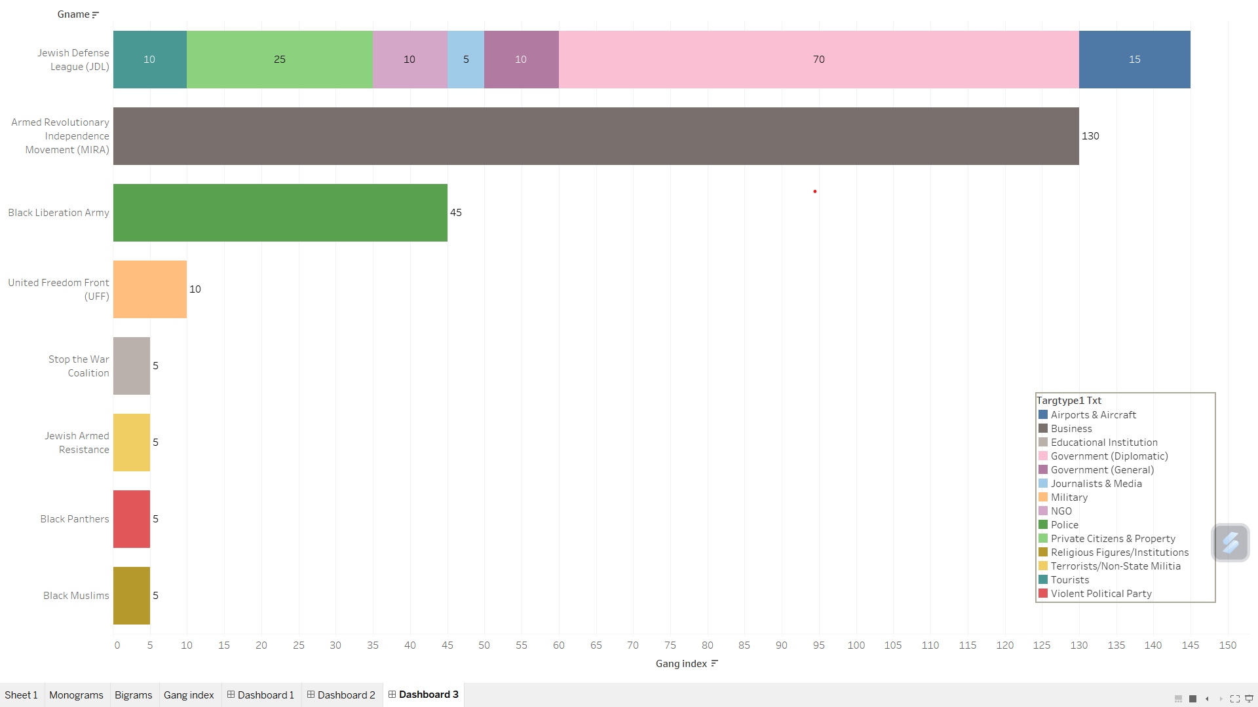
Domestic New York Gangs
Jewish Defense League (JDL) has actively attacked New York with no specific target in mind
Armed Revolutionary Independence Movement (MIRA) has actively and specifically targeted Businesses
Rest of the gangs also have specific targets

Slide 25
Future Analysis
Counter terrorism can be identified using predictive analytics, Where ML models can be used to identify patterns and predict future terrorist events based on datasets.
As the data volume increases with change of time, the ability to process and analyse information for decision making becomes crucial.
Integrating the data from various sources can provide a clear view of threat and can be used for analyzing the pattern of attacks.
To analyze the data and predict the upcoming terrorist attacks in future, involves using statistical techniques, ML models.
Further, we identify features from the data which indicate the potential threat of terrorist attacks based on the activities.
Based on the potential threats, the preventive measures are implemented to safeguard the innocent people from such attacks.

Slide 26
Conclusion
What are the emerging trends in Terrorist activities globally over a decade?
Bombing leads the most attack type perpetrated since 1970, Armed Assaults next. Both increased during the Arab Spring.
Unknown attack type increased to the third since pandemic, possibly due to lack of law enforcement.
How to assess the past risk levels of terrorist activities?
We designed our unique assessment model based on the distribution of the data and the casualty.
How can we support counter terrorism decision making regionally using Global Terrorism Database(GTD)?
We implemented an ad-hoc report generation system based on the processed and risk level labeled GTD, output the report and visualization of comparison of risk level between user input area and globe, top words that occurred in related news, and the most active terrorist group(s) related.

